Slide 1

Superstore Sales & Profit Analysis
Data Storytelling & Statistical Validation
ApexPlanet Internship
2025

Slide 2
Business Objective
Analyze overall business performance using sales data
Identify profitable and loss-making products
Understand relationship between sales and profit
Support data-driven decision-making using dashboards

Slide 3
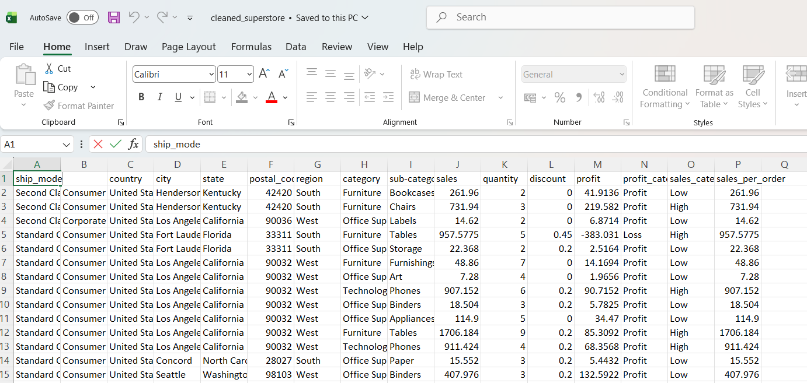
Dataset Overview
Key Features:
Sales
Profit
Quantity
Region
Category
Sub-Category
Discount
Tools Used:
Python (Pandas)
Power BI
VS Code
Dataset: Sample Superstore Dataset

Slide 4
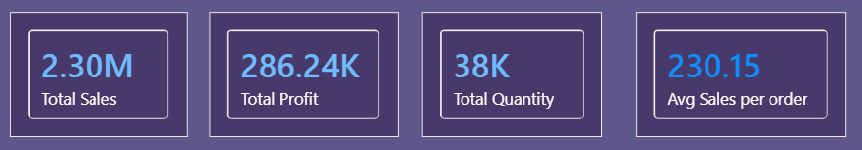
Key Business KPIs
Total Sales: 2.30M
Total Profit: 286.24K
Total Quantity: 38K
Avg Sales per Order: 230.15

Slide 5
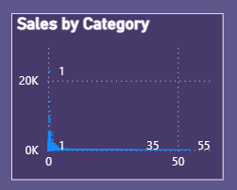
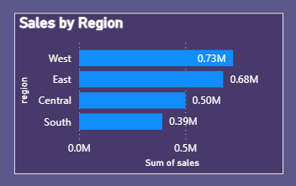
Sales Performance Analysis
Observations:
Technology category generated highest sales
West region showed strong performance
Sales vary significantly across categories and regions

Slide 6
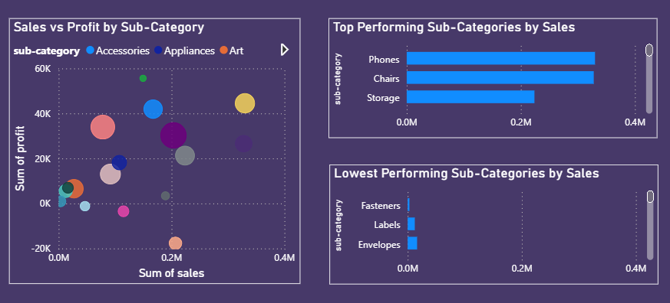
Product Deep-Dive Analysis
Key Findings:
Some products generate high sales but low profit
Discounts reduce profitability
Top and low-performing products were identified

Slide 7
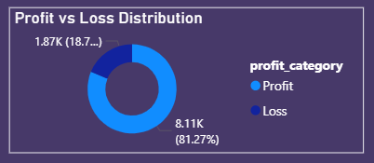
Profit vs Loss Distribution
Observation:
Majority of transactions generate profit
Some products still result in losses
Business Insight:
Excessive discounts negatively impact profitability.

Slide 8
Hypothesis Testing
Hypothesis:
Higher discounts reduce profitability.
H₀ (Null Hypothesis):
Discounts do not affect profit.
H₁ (Alternative Hypothesis):
Higher discounts negatively impact profit.
Observation:
Products with higher discounts often show lower or negative profit values.
Conclusion:
The analysis supports the hypothesis that excessive discounts reduce profitability.

Slide 9
Business Recommendations
Reduce unnecessary discounts
Focus on profitable products
Improve pricing strategies
Monitor low-performing products
Increase focus on high-performing regions

Slide 10
Conclusion
This project demonstrates how data analytics and visualization techniques can transform raw business data into meaningful insights and support better decision-making.

Slide 11
Thank You

